Slide 1
Programming Prolog

Slide 2
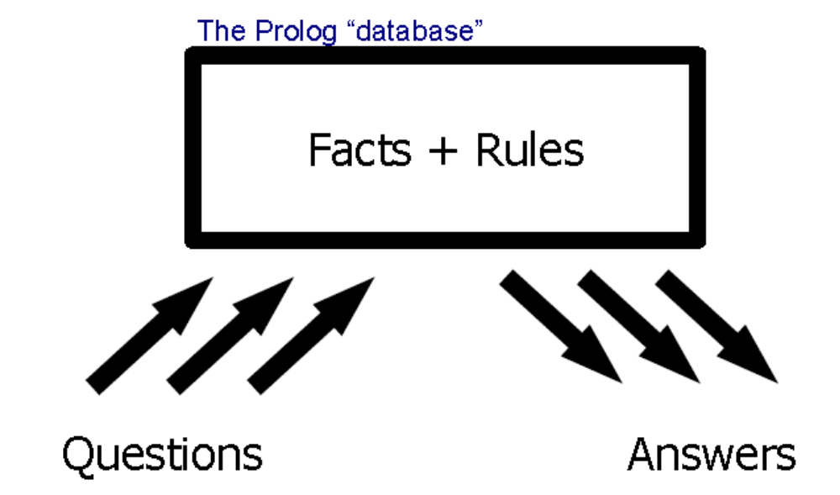
Prolog Programs

Slide 3
Introduction
Came from the field of Natural Language Processing in 1973
PROgramming en LOGique (Programming in Logic)
We construct Rules and Facts in Prolog commonly known as database or knowledebase

Slide 4
Simple Program
[user].
milestone(x,1990).
milestone(xii,1992).
milestone(ba,1995).
milestone(ma,1997).
milestone(bca,1995).
milestone(msc,1997).
Type CTRL – D when you are finish.

Slide 5
Query you database
?- milestone(ba,1990).
No
?- milestone(ba,1995).
Yes
?- milestone(X,1995).
X = ba
Yes
halt. ----------- Should be used when want to quit
If you have more then one result then use ; or w to see next result

Slide 6
Building Blocks of Prolog
Constants
  Numbers: 1 -40 3.4
  Atoms: tiger ‘Hello World’
Variables
  X A_variable Avariable _
Compound terms
  milestone(ba,1990) likes(ram,shyam)
Each term in Prolog is either a constant, or variable or compound term

Slide 7
Building Block (Contd)
To write on screen
  write(compound term). e.g. write(‘Hello’).
Data Types in C/C++/Jave are termed as Domains
char ‘a’ ‘%’ – Anyting with ‘ a’
integer 100 -100 0 -32768 – whole numbers between 32767 to -32768
real 32768 99 99.01 3.00 e+10
  Range between 10⁻³⁰⁷ to 10³⁰⁸

Slide 8
Building Blocks
String --- anything enclosed between “ ”
Symbol --- sequences of alphabets from (a-z|A-Z) or numbers(0-9) or (_)
  Provided first character is a lowercase alphabet

Slide 9
Exercise
Display your name on screen
Construct the following databse
  baber was father of humayun
  humayun was father of akbar
  akbar was father of jahagir
  jahagir was father of shahjhan
  shahjhan was father of auranzeb
Ask following questions

Slide 10
Questions
Display list of all the fathers and sons
Who was the father of akbar
Who is son of akbar
Who is grandfather of akbar
Who is grandson of akbar

Slide 11
Define the following Facts
ram is my friend
hexagon has 6 edges
rabrindranath tagore wrote gitanjali
Telephone 101 in case of fire
Kasturba was wife of Gandhi
There are 11 players in cricket
Paris is capital of France
Graham Bell invented telephone

Slide 12
Defining rules
Rules can be define as
grandfather(X,Z) :- father(X,Y),father(Y,Z).
X is grandfather of Z if X is father of Y and Y is father of Z
Note: this is something different than conventional programming, here result is defined first and then the rules that would deduce that result.
While consulting we would on give
?-grandfather(X,akbar).
?-grandfather(akbar,X).

Slide 13
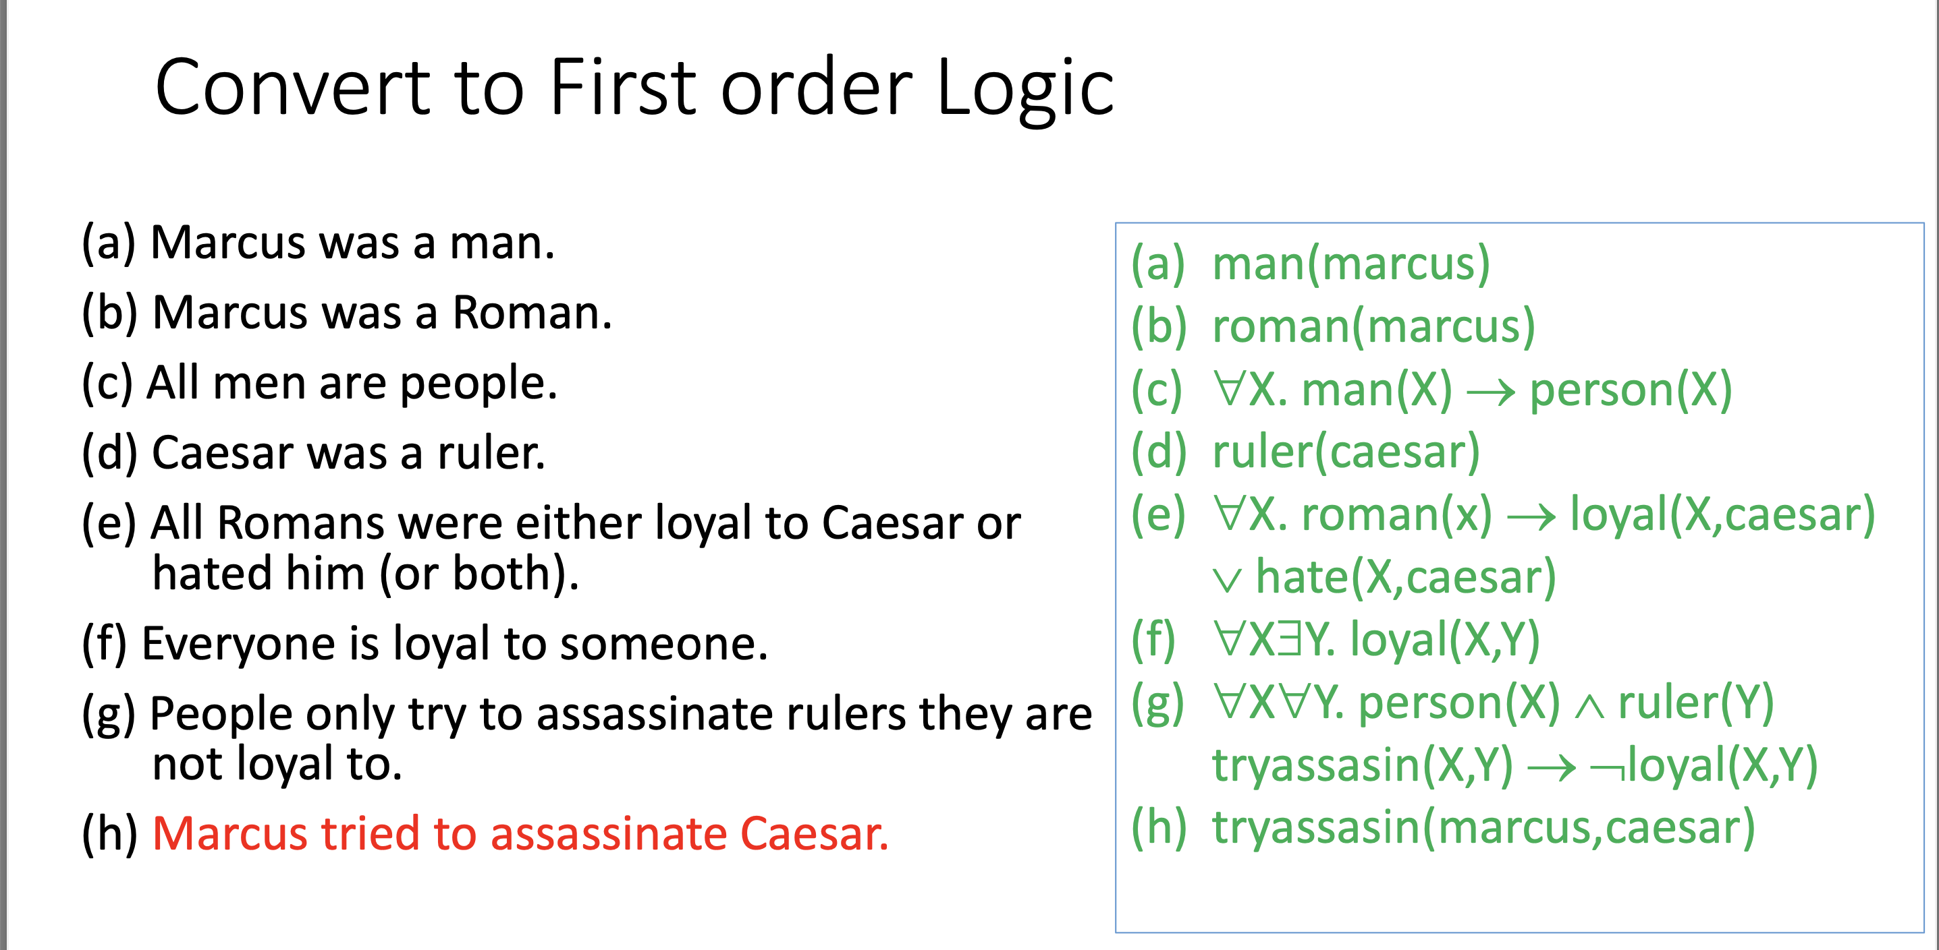

Slide 14
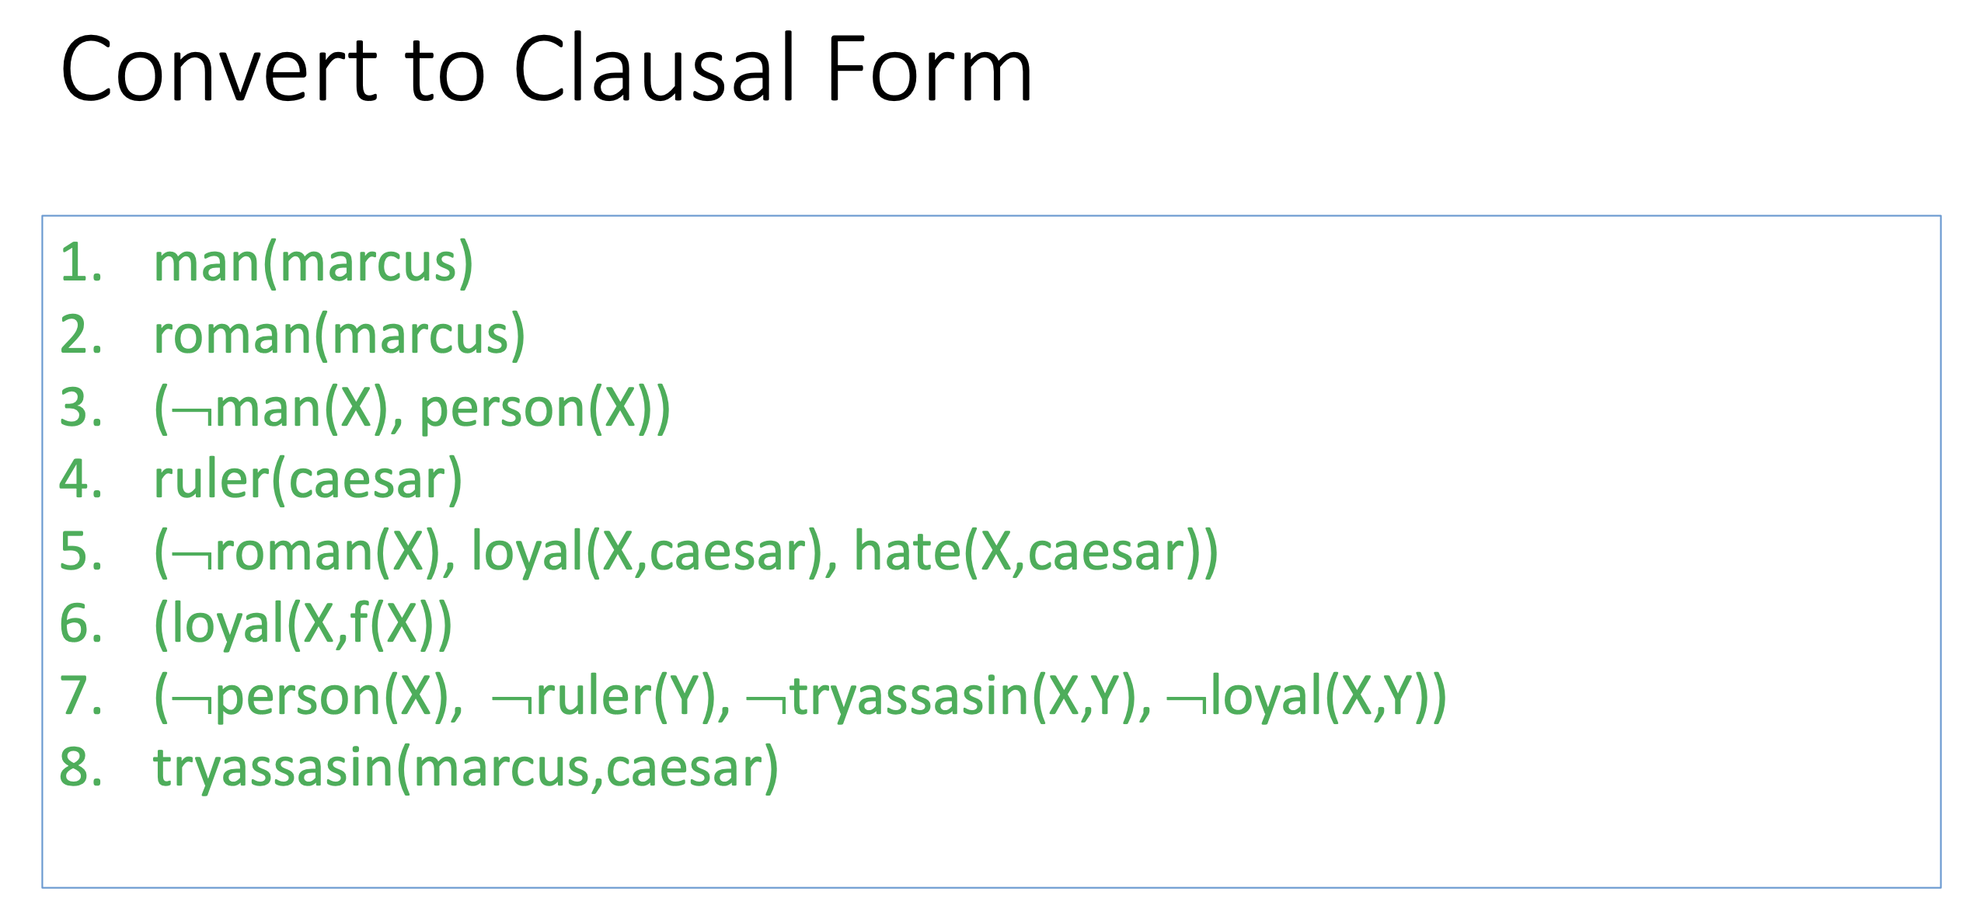

Slide 15
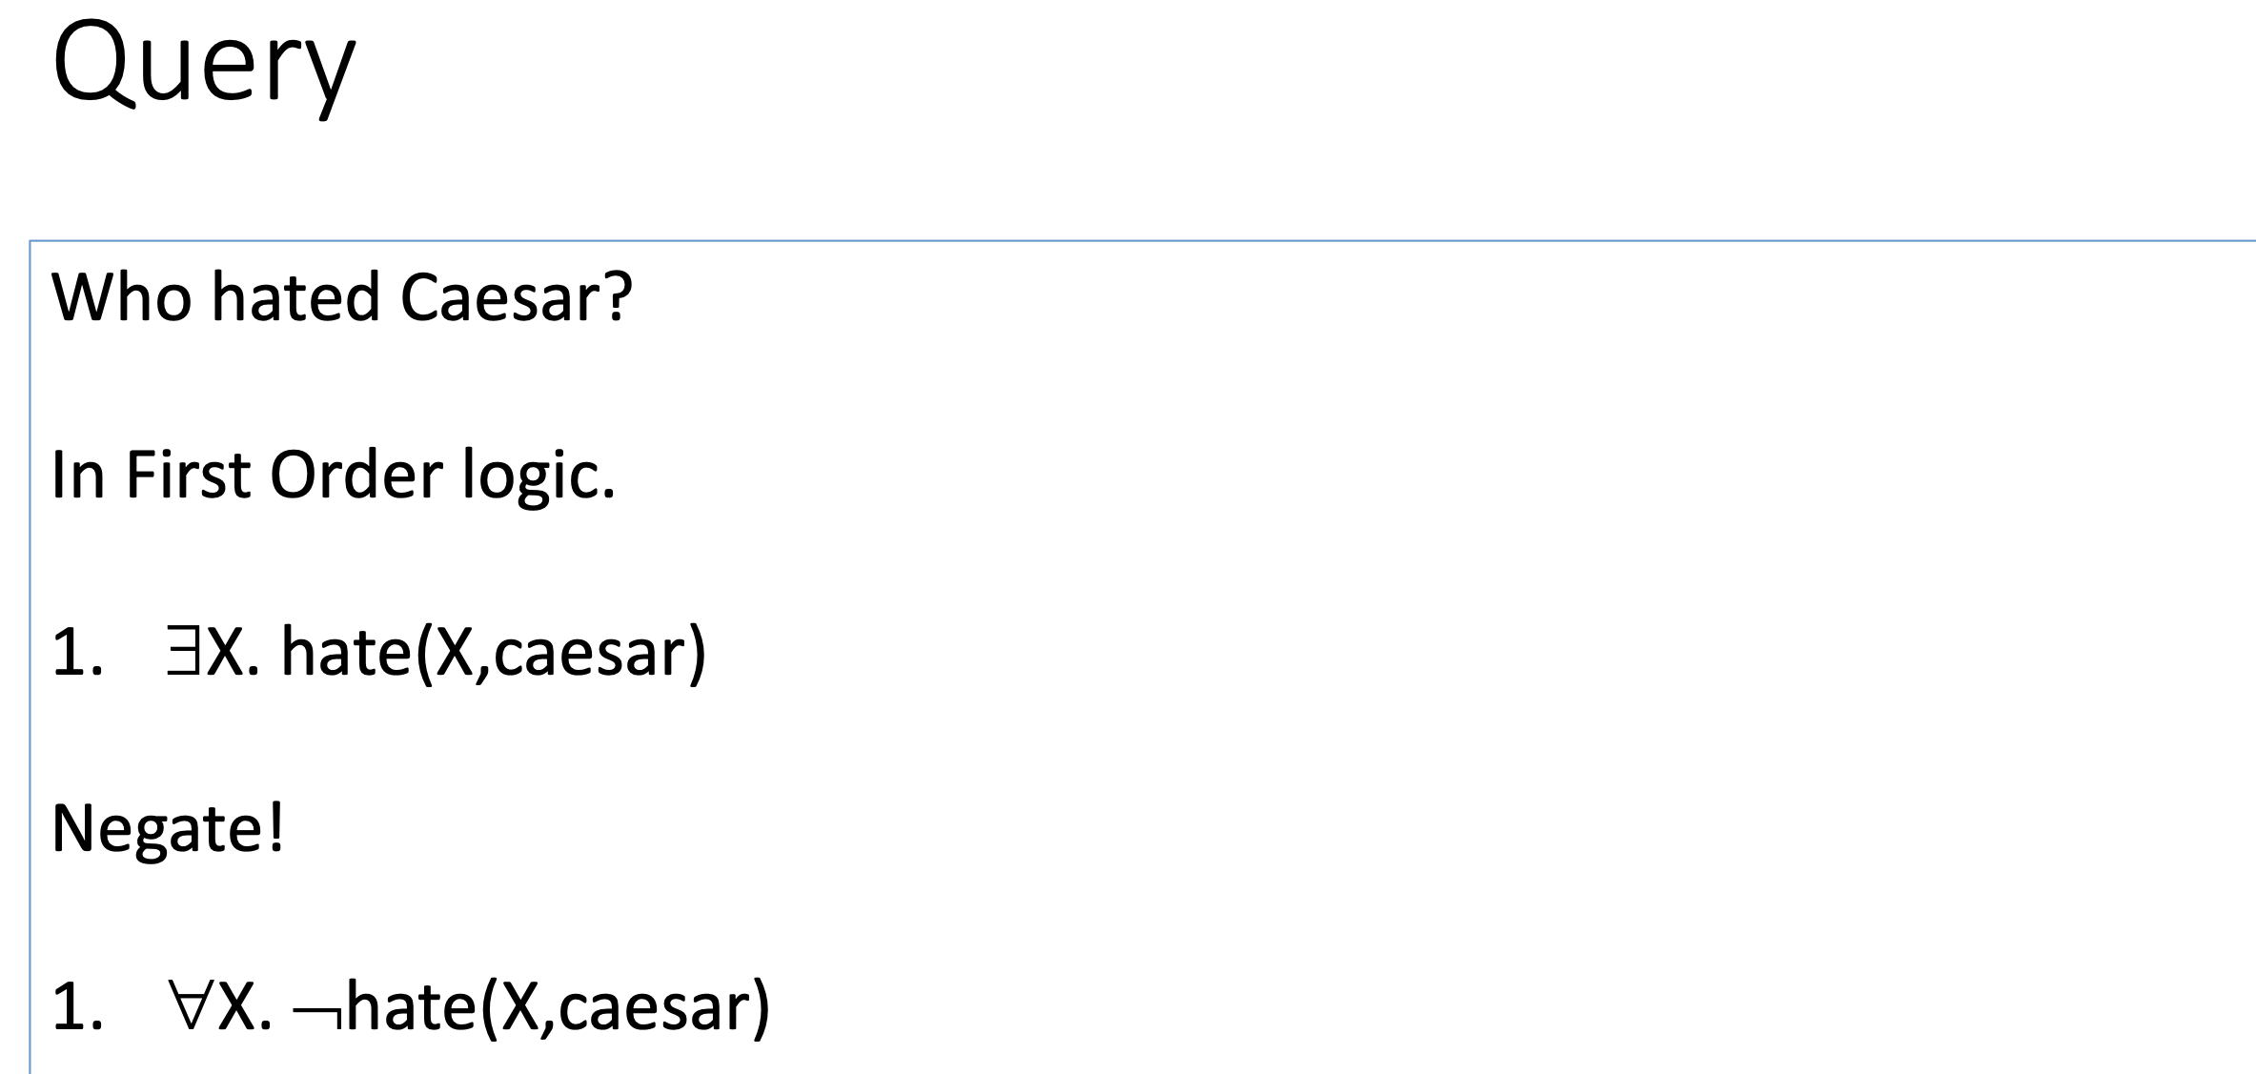

Slide 16
